Slide 1
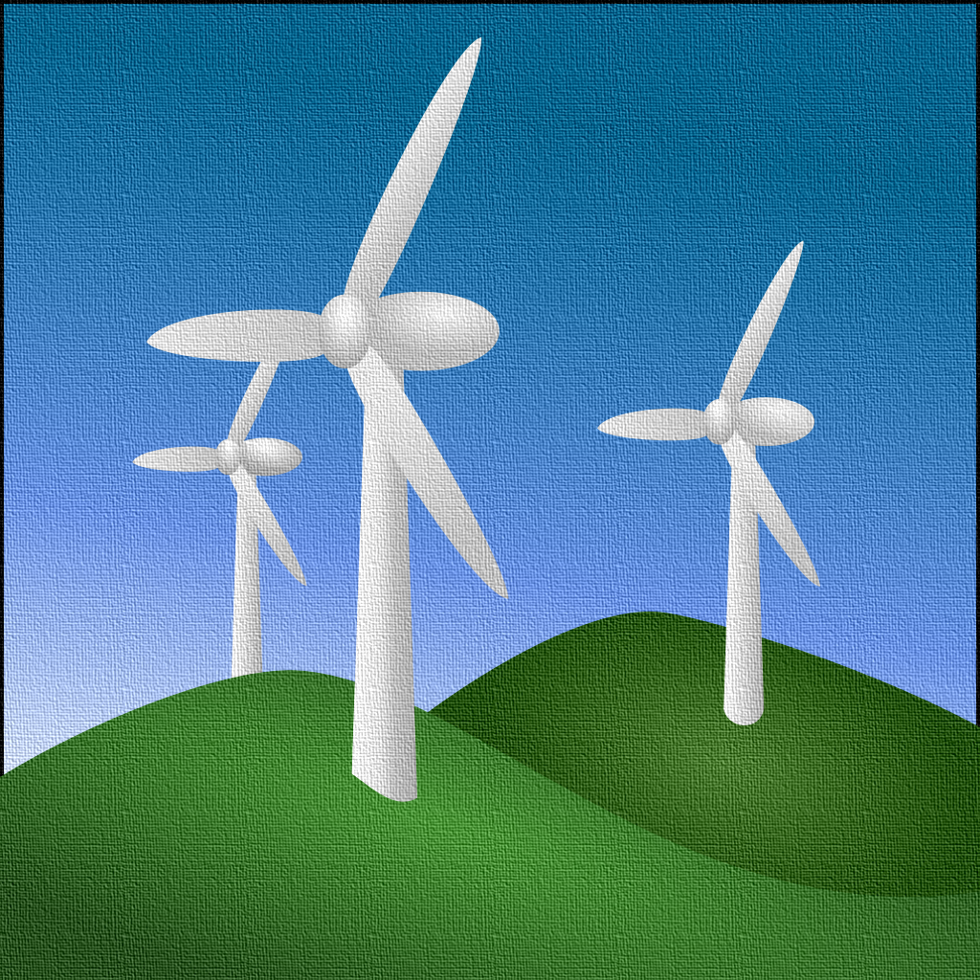

Sustainability Analysis of a Pedestrian Bridge made from Repurposed
Wind Turbine Blades
Angela Nagle
University College Cork, Ireland
27 August, 2020

Slide 2
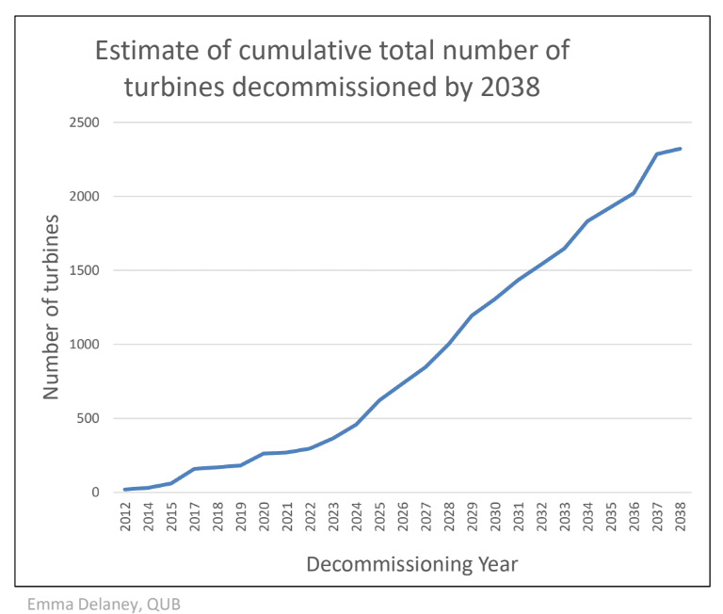
Wind Turbine Blade Waste Problem in Ireland
Blades are Glass Fibre Reinforced Polymer (GFRP)
GFRP is difficult to recycle!
Turbines have 20 expected lifespan*
12-15 tonnes of GFRP material per MW of power (Jensen and Skelton, 2018)
By 2038, 2323 turbines expected to be decommissioned in Ireland
(estimated 64,800 tonnes of GFRP waste)
* Some wind farms are extending life up to 25-30 years, but this simply pushes waste problem out 5-10 years

Slide 3
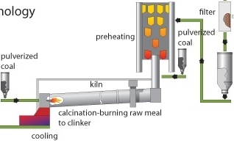
Current EoL Options for Blade Waste
Baseline Disposal Scenario: Cement co-processing is the most sustainable technology currently in high volume production (Nagle et al, 2020)
Pyrolysis & Mechanical Grinding are not economically viable for GFRP (WindEurope, 2020)
Environmental gains are made by using blade waste to substitute fuel and clinker raw material in cement co-processing

Slide 4
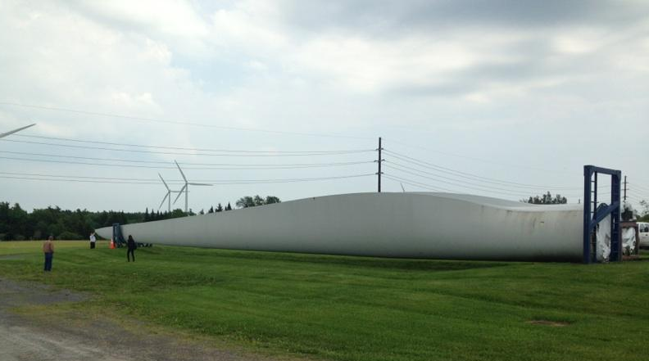
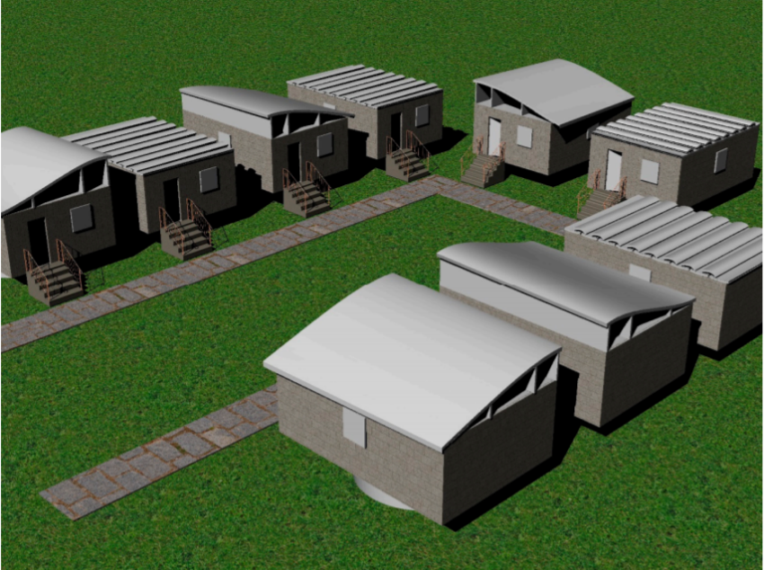



Re-Wind Project
Sustainable Repurposing of Composite Wind Turbine Blade Waste
Expected Outcome: Viable businesses models for Wind Blade Repurposing that are sustainable.
https://www.re-wind.info/

Slide 5
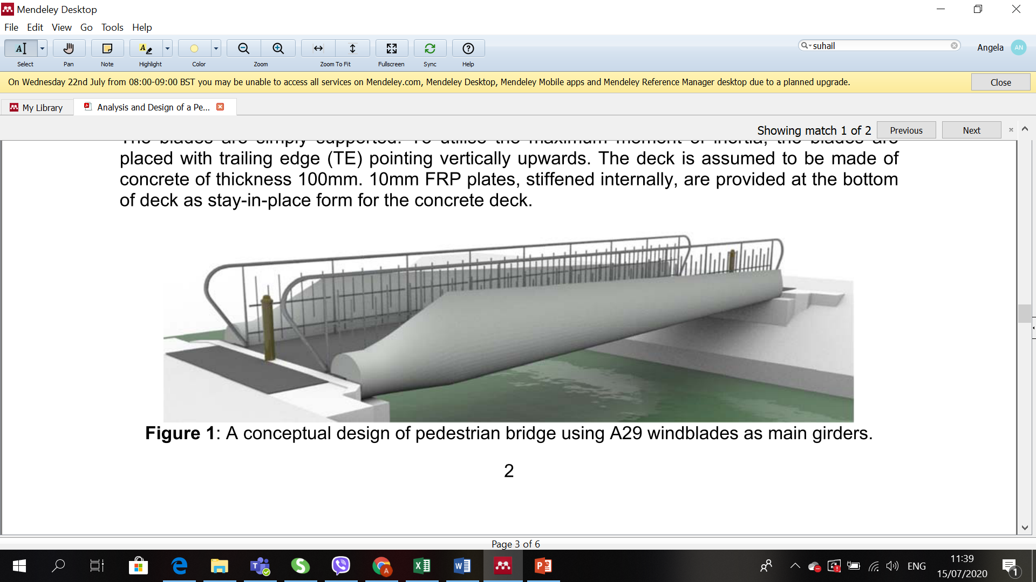
Pedestrian Blade Bridge Design
Short span pedestrian bridge designed using the lower section of two decommissioned turbine blades
(Suhail et al, 2019)
Excellent Irish Opportunity Exists!
2020 Irish Program for Government: €1 million/day on cycle & walking infrastructure
EU Public Procurement for a Circular Economy encourages sourcing repurposed material

Slide 6
LCA Boundary Setting & Assumptions
Functional Unit: Disposition of 4500 kg blade waste over 60 years (Cradle to Grave)
Blades cut, then transported across Ireland for remanufacturing
Lower 2/3 blade replaces steel girders
Top 1/3 blade sent to landfill
Blades coated in epoxy protective layer
EoL Plan: Co-processing of GFRP girders, recycling of hardware
Wooden decking material, abutments, and maintenance schedule assumed equal to blade made with steel girders

Slide 7
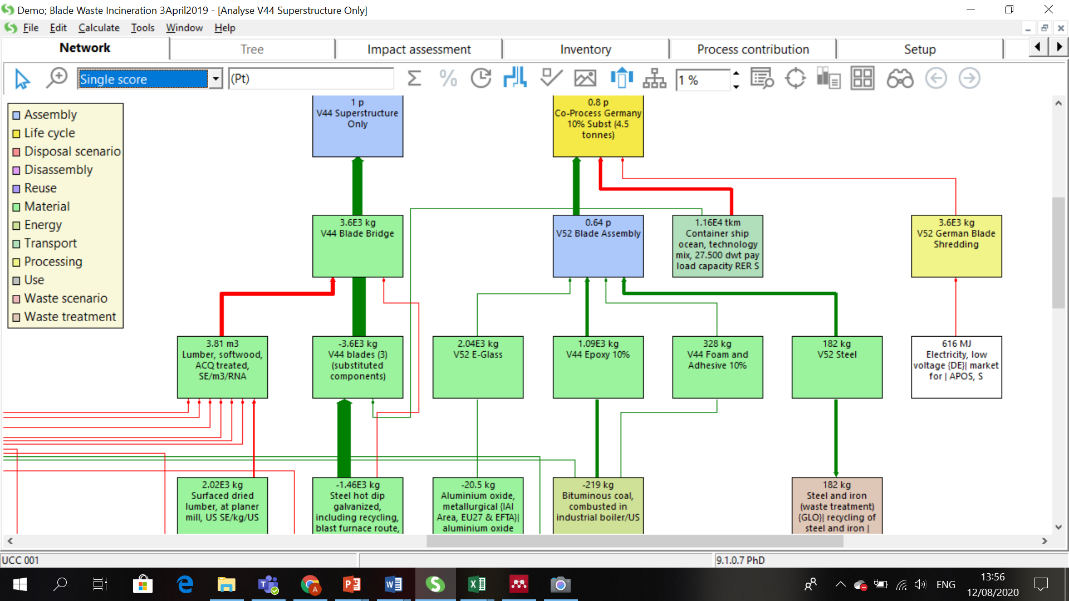
LCA Data (1): Comparison of the Impact of the Baseline v. Repurposing as Bridge Girders
Co-processing is compared to the substitution of the steel girders + co-processing at EoL

Slide 8
LCA Data (2): Impact of the Full Bridge Assembly
The full bridge assembly has more impact than the benefits gained in replacing the steel girders with blade waste

Slide 9
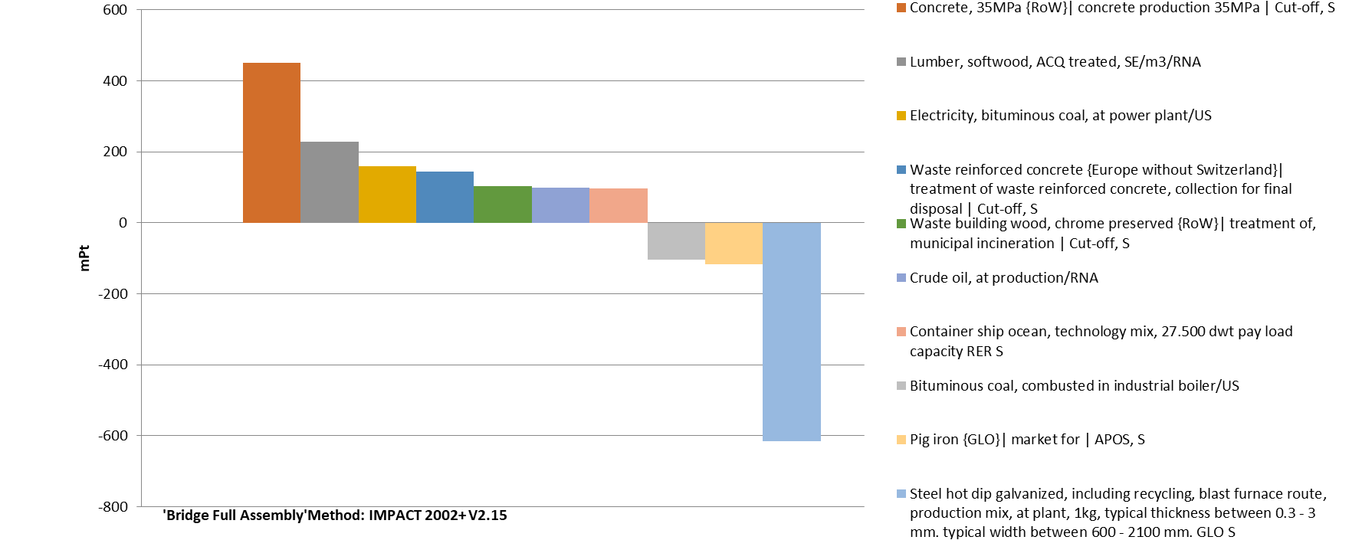
LCA Data (3): Process Impacts of Full Bridge Assembly

Slide 10
Discussion of Actual Impacts
Repurposing of wind turbine blades as girders for pedestrian bridges is environmentally better than the baseline disposal method of co-processing in a cement kiln.
However, the positive impacts of this project are more likely in the awareness raising of ‘developing projects that can inspire and showcase the potential of a circular economy’. Ellen Macarthur says: Setting up exemplar projects in strategic places in the city can be an inspiring way to demonstrate what is practically possible... (Ellen Macarthur Foundation, 2019)

Slide 11
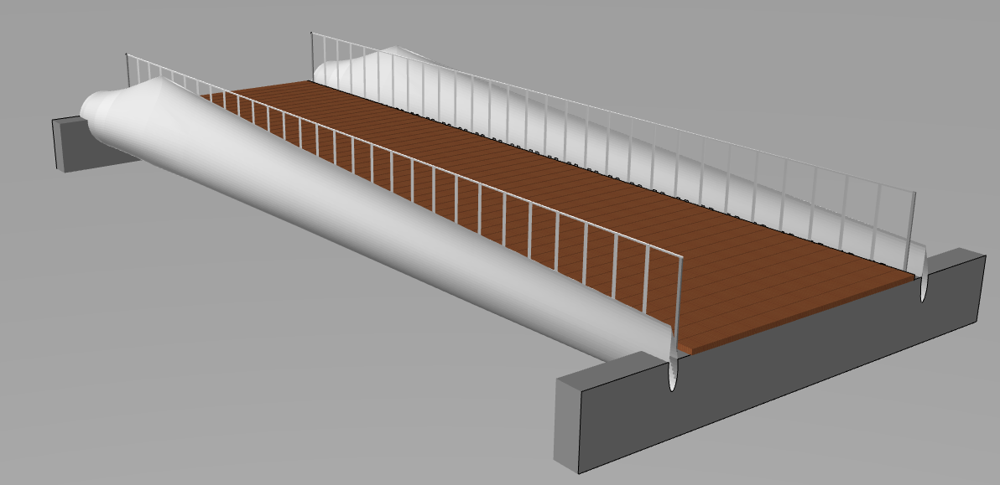
Future Plans
Blade Bridge Project Status: Re-Wind is working with Cork County Council to design short span (8–15m) cattle and road flyover bridges along a new 23km cycleway. Limiting factor at the moment is sourcing blade waste!
Future Research Plans: Complete a Future Scenario Assessment and LCSA! Use the Sustainable Development Goals to select/create social indicators for the LCSA. Estimate GFRP recycling scenarios for 2080 in order to run consequential LCA on future GFRP disposal options.

Slide 12
Thank You!!
AngelaJaneNagle@umail.ucc.ie

